Slide 1
Data visualization and Algorithms Techniques for Breast Cancer Prediction and Classification with High Accuracy Rates
CSCI-208 Design and Analysis of Algorithms
Dr.Hala Zayed
Eng. Ammar & Tasneem

Slide 2
Table of Contents
1
2
3
Introduction
Methods
Datasets
4
5
6
Future work& References
Results
Conclusion
Proplem Definition
Methodology used
Preparations &
Preprocessing
High Quality Figures
Discussion and Conclusion
References used

Slide 3
1
Introduction

Slide 4

Problem Definition
Breast Cancer is one of a major issue that some of the women are facing today.
Earlier detection of cancer by performing detailed analysis based on the existing records which may assist the physicians in providing a better treatment to their patients.

Slide 5
Problem Definition
The diagnosis of breast cancer is dependent on a variety of parameters.
We aim to create the best model for predicting breast cancer through preprocessing, feature extraction, data visualization and prediction using breast cancer data.
Various visualization techniques like violin plot, grid plot, swarm plot and heat plot were utilized for proper feature extraction which has improved the accuracy of our results.
For the purpose of prediction, we have used algorithms like the random forest, decision tree with single and multiple predictors, along with the commonly used statistical model, logistic regression model.

Slide 6
2
Methods

Slide 7
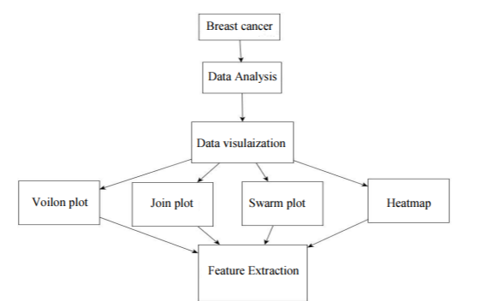
1. Data visualization and Algorithms
A basic data analysis is carried out to look at the pattern of data.
Firstly, the mean values of cell radius, perimeter, area, compactness, concavity and concave points can be used in the classification of cancer. Larger values of these parameters tend to show a correlation with malignant tumors.
Secondly, the mean values of texture, smoothness, symmetry or factual dimension do not show a particular preference of one diagnosis over the other

Slide 8
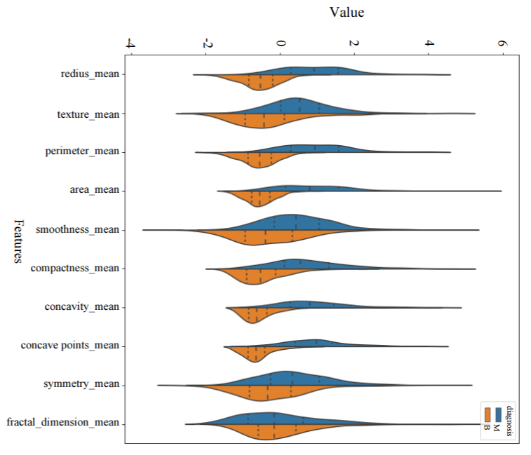
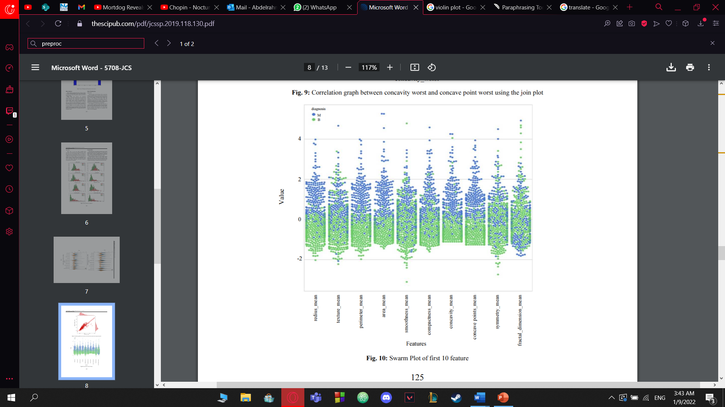
2. Data visualization
Violin plot
in texture mean feature, the median of the Malignant and Benign looks like separated so it can be good for classification. However, in the fractal dimension mean feature, median of the Malignant and Benign does not look like separated so it does not give good information for classification.
Swarm plot
the variance can be seen more clearly. In this plot which feature looks like more clear in terms of classification. Here
from the area worst feature in the last swarm plot looks
malignant and benign are separated not totally but mostly

Slide 9
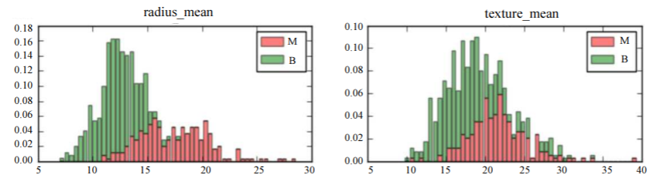
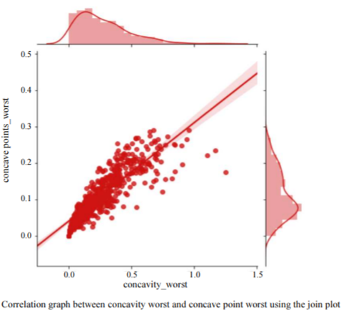
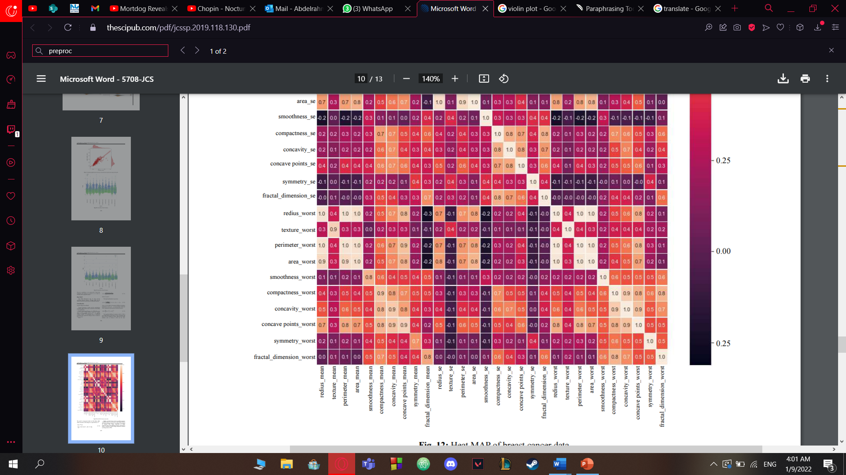
2. Data visualization
3. Join plot
In the first join plot graph one can easily conclude that
concavity worst and point worst predicted from violin
plot turn out to be correlated. Hence, one feature is
dropped instead of taking both the features. In order to
compare two features deeper, we can use joint plot as
shown in the next graph. Pearson value is correlation value
and 1 is the highest. Therefore, 0.86 looks enough to
say that they are correlated.
4. Heat Map
shows all the correlation between features. Through which all the
features which are not relevant are eradicated from this

Slide 10
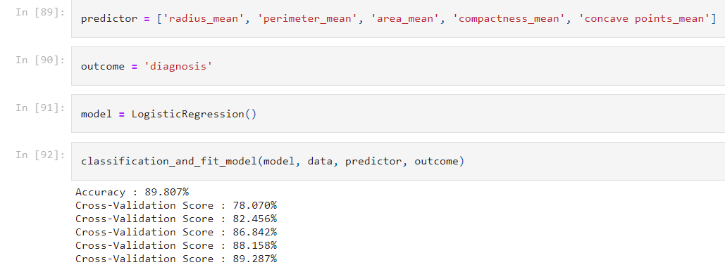
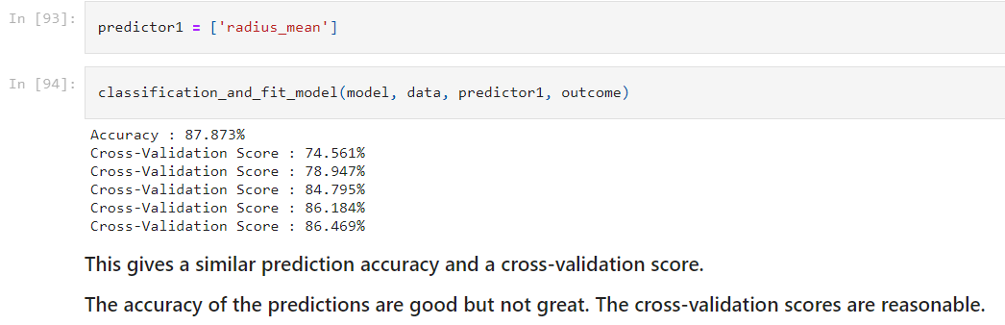
3. Algorithms
1. Logistic Regression Model
We used a Logistic Regression which is a Machine Learning predictive analysis algorithm in order to classify our problem, and predict the probability of a target variable. It is one of the simplest ML algorithms that can be used for various classification problems so we used it here in cancer detection. So here, based on the observations in the histogram plots, we can reasonably hypothesize that the cancer diagnosis depends on the mean cell radius, mean perimeter, mean area, mean compactness, mean concavity and mean concave points. We can then perform a logistic regression analysis using those features as follows:

Slide 11
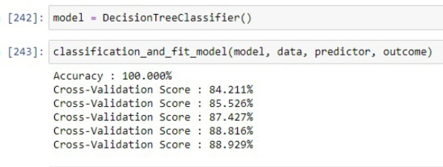
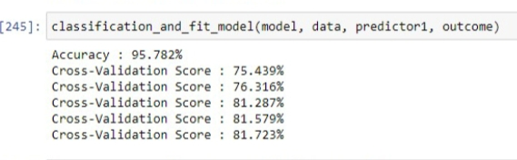
J4is was used Here, which is a simplistic learning supervised technique. This Algorithm employs the concept of ID3 to build a Decision tree by a top-down approach which is a greedy Search through training data where each and every Attribute is tested at each node while building a tree. It Uses Information gain which is a measure of the decrease In entropy of attribute after the split of the dataset.
Decision Tree Model
3. Algorithms
2. Decision Tree Model

Slide 12
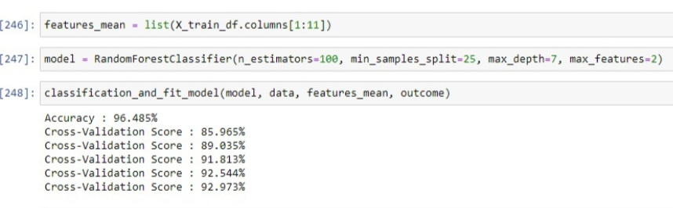
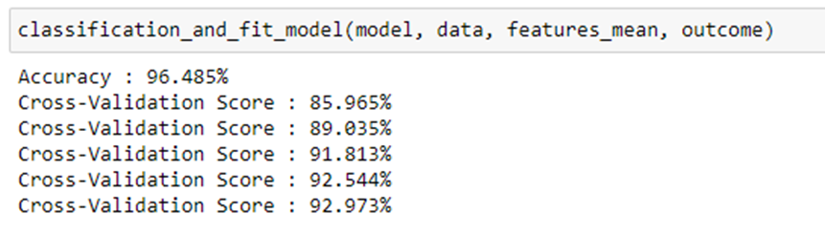
3.Algorithms
3.Random Forest Model
Is an ensemble of Decision tress, classifier creates a set of decision trees From a randomly selected subset of the training set. Using all the features improves the prediction Accuracy and the cross-validation score is great.
4.Support Vector Machine (SVM)
96% accuracy on test data. We used it for solving classification problems are those that necessitate categorizing a given data set into two or more categories.

Slide 13

3
Dataset

Slide 14
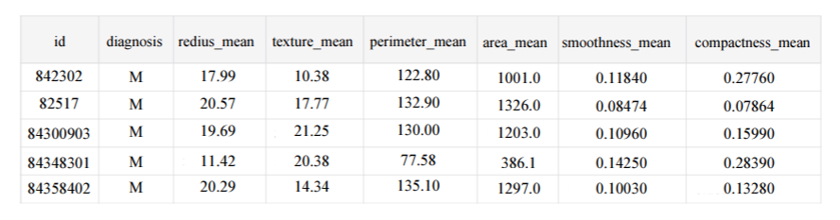
2. Dataset preparations & preprocessing
The dataset that we use is taken from UCI Machine Learning
Remove non-required columns such as id and nameless ones.
Map the diagnosis column into numeric form; The diagnosis column is not numeric and must be transformed so that the algorithm can analyze and grasp the data.

Slide 15
2. Dataset preparations & preprocessing
Description of attributes in our dataset:
Attribute Information: (1) ID number (2) Diagnosis (M = malignant, B = benign) 3-32) Ten real-valued features are computed for each cell nucleus: These attributes are radius which is mean of distances from center to points on the perimeter, texture which is standard deviation of gray-scale values, perimeter, area, smoothness which is local variation in radius lengths, compactness which is perimeter^2/area - 1.0,concavity which is severity of concave portions of the contour, concave points which signifies number of concave
All feature values are recoded with four significant digits. Missing attribute values: None the class distribution contains 357 benign tumors and 212 malignant tumors.

Slide 16

4
Results

Slide 17
Our Results
In our results, different models were used, trained and tested.
The accuracy was predicted for all these models and k-fold cross-validation was performed on the training data to improve and correctly predict the accuracy. Out of all the results, random forest came out to be the best model in terms of classification with an accuracy score of high rate. The results shows that random forest turns out to be the most accurate model in terms of accuracy and 5-fold cross validation score.

Slide 18
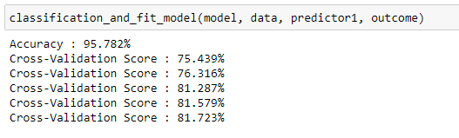
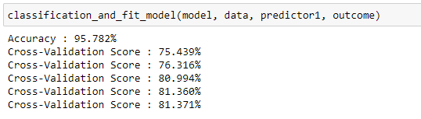
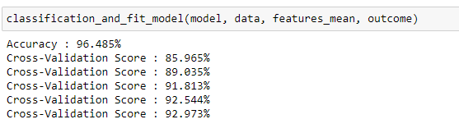
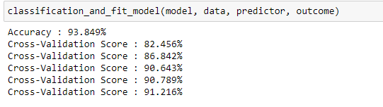
Results
This figure shows: With using predictor1 gives a better prediction accuracy, but the cross-validation is not great.
This Figure shows: Using all the features improves the prediction accuracy and the cross-validation score is great which gives a better prediction accuracy, but the cross-validation is not great.

Slide 19
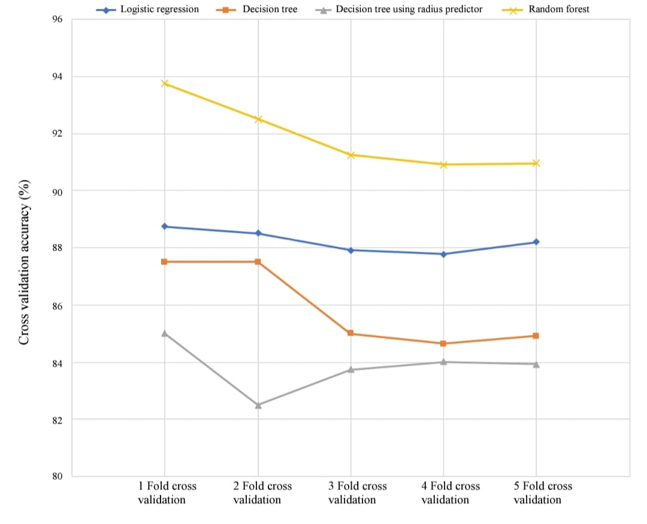
Our Results
This figure shows:
Comparative analysis of various models-Measure of cross-validation accuracy between various models.

Slide 20
5
Discussion& Conclusion

Slide 21
By using Data visualization & Algorithms to diagnose breast cancer we concluded:
Concluding that the Random forest classifier is the most accurate model in diagnosing breast cancer using data visualization.
Evaluating models in terms of accuracy and cross-validation.
Resulting of an accuracy of ~95% and a cross-validation score of ~93% for the test data.
Excluding some features and determine which ones are significant..
~93% ~95%
Finding that, Random-Forest Model with top 5 predictors is the best model to apply for diagnosing breast cancer.
Jan
Feb
Mar

Slide 22
Future work & Suggestions
6

Slide 23
What Are We Going to do?
In our project future work, we can develop a robust data analytical model with algorithm which can assist in better understanding of breast cancer survivability, providing better insights into factors associated with patient survival, and establishing cohorts of patients that share similar properties. In addition, the results of our analysis and algorithms implemented can be used to segment the historical patient data into clusters or subsets, which share common values. Furthermore, providing enhanced computational visualization and algorithms and thus saving patients’ lives.

Slide 24
7
References

Slide 25

References
Williams, K., P.A. Idowu, J.A. Balogun and A.I. Oluwaranti, 2015. Breast cancer risk prediction using data mining classification techniques. .Trans. Netw. Commun. DOI: 10.14738/tnc.32.662.
Wolberg, W.H., W.N. Street and O.L. Mangasarian, 1994. Machine learning techniques to diagnose breast cancer from image-processed nuclear features of fine needle aspirates. Cancer Lett., 77: 163-71. DOI: 10.1016/0304-3835(94)90099-x.perly

Slide 26
Our Team
Shrouk Hesham
1
2
Hussin Fekry
3
4
Asmaa Muhammed
Shrief Refa3y
19106271
19100006
19105777
19200036

Slide 27
Thanks!
DO YOU HAVE ANY QUESTIONS?

